Slide 1
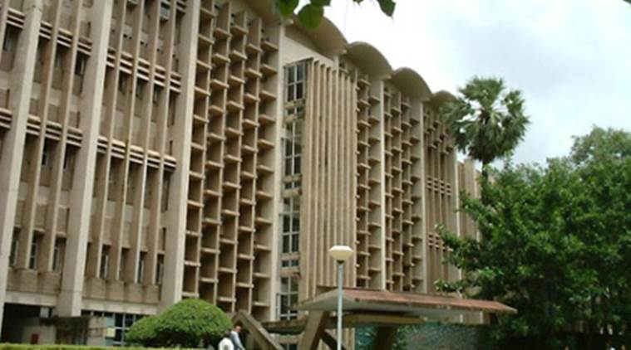
The road after Hogwarts
Vipul Harsh

Slide 2
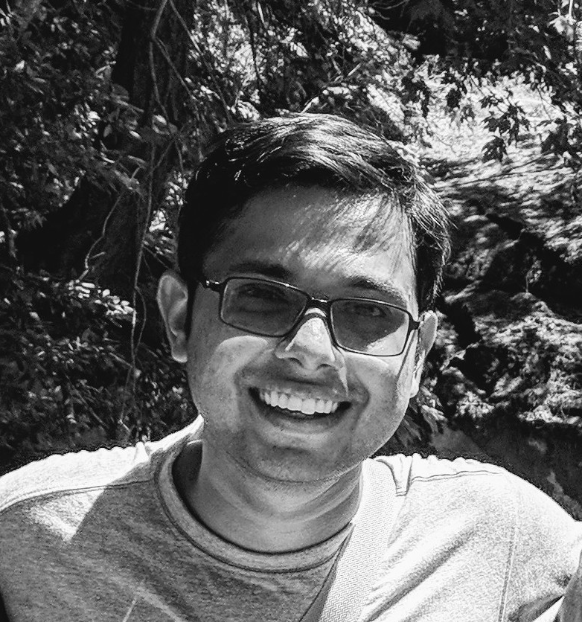
About me
Graduated with a Ph.D. from UIUC
  worked on systems, networking and algorithms
Currently a post-doc researcher at an academic startup
  working on projects close to my PhD research
Many years ago, a spirited undergrad at CSE, IITB 😁

Slide 3




What can you do after graduating from IITB
Start your company
or
work at an early-stage startup
Research
(Ph.D. or Masters)
Work at an established company
Non-CS

Slide 4
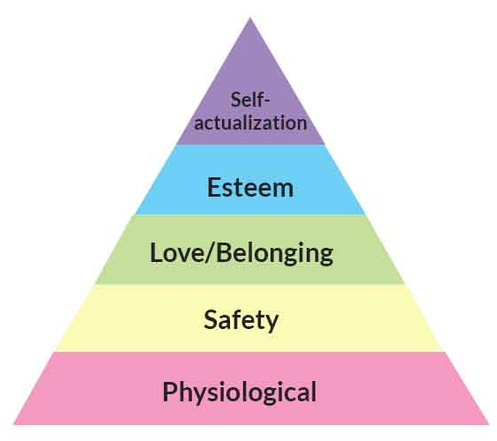
What metrics should you consider?
Self fulfillment, satisfaction
Money
Intellectual stimulation
Long term personal goals

Slide 5
What can you do after graduating from IITB
Start your company
or
work at an early-stage startup
Research
(Ph.D. or Masters)
Work at an established company
Non-CS

Slide 6
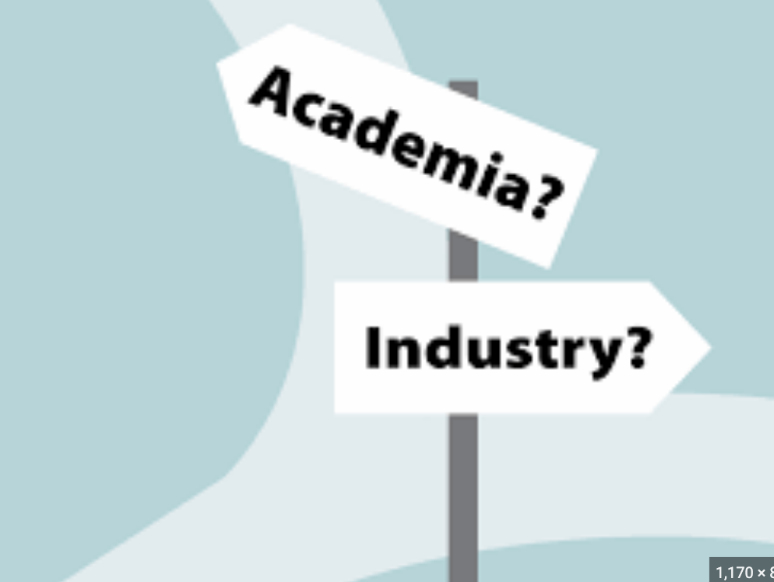
Research life
Pros: freedom, do what you like
Cons: freedom, do what you like

Slide 7
Research life
Pros:
  Work on interesting problems that you like
  Work with very smart and talented people
  You can start a company (many researchers have built successful companies)
Cons:
  Easy to become adrift
  Have to drive your own work
  Stressful
  Less pay than industry (unless you build something successful that sells)

Slide 8
Preparing for an academic application
(PhD or Masters)
Most important: get research experience working with a faculty
  a publication at a good conference/journal is invaluable
For US/Europe: recommendation letters are very important
  ask professors who can talk about your work
For India: GATE exam → submit application → interview call
Maintain a good academic standing
  strong research performance can override bad grades (to some extent)

Slide 9
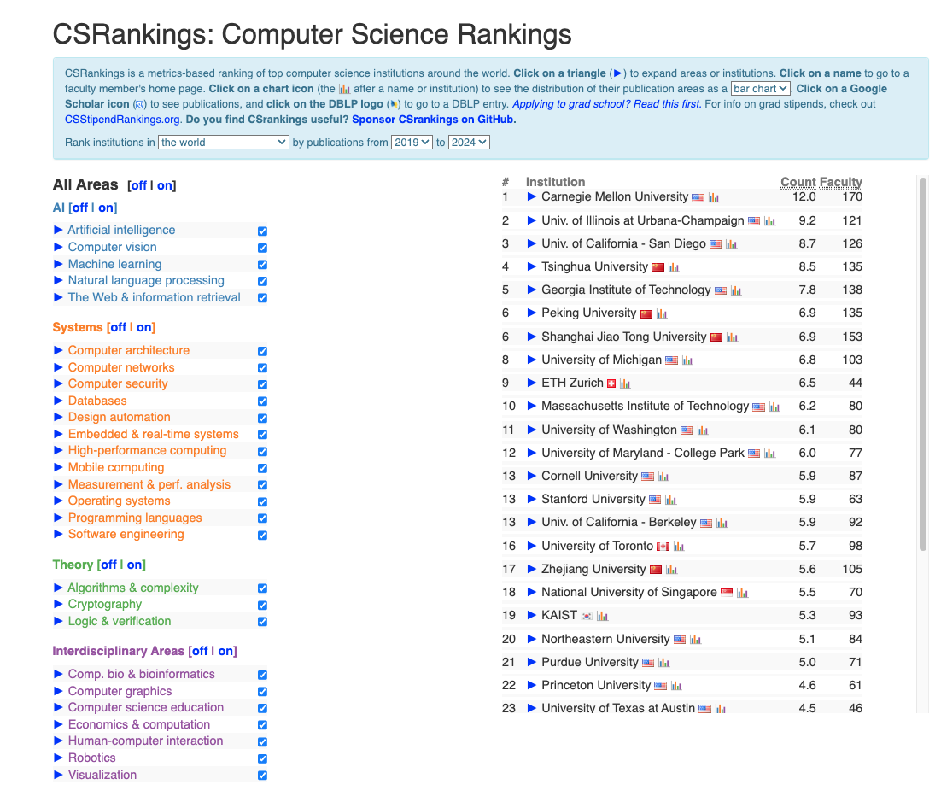
Where to apply for Ph.D.?
Visit csrankings.org
Find faculty who have published in your area in the last 5 years
(skim their papers, do those projects resonate with you?)

Slide 10
Evaluating a potential PhD advisor
(most important part of PhD)
Is the advisor a nice and a supportive person?
Has the advisor been actively publishing in the last 5 years in top conferences?
Do you like their research taste? (e.g. more theoretical, more experimental etc.)
Where are their past students now?
Would their style of advising suit you?

Slide 11
Which area(s) should I apply in?
Machine learning
Blockchains
Machine learning for blockchains
While it’s a good idea to work in an upcoming area, seek to develop some general skills in a broad area
Upcoming area will keep changing ☺

Slide 12
Which area(s) should I apply in?
IMO first find an advisor whose work resonates with you and then worry about a research area
Use some intuition about what areas you might like:
  do you like building large systems or proving theorems or making machines more intelligent?
Have an open mind, but don’t confuse someone else’s enthusiasm for your passion
  what’s your skillset?
  what kind of projects will make you get out of bed?

Slide 13
What if unsure about academia (PhD)?
can consider a research-focused Masters or "pre-doc" research assistantship
completely fine to work in the industry for some time before applying
  but try to get some research experience while you can

Slide 14
Working at a startup
Fast self-growth
Lead and own significant chunks of a project
High rewards if successful
Cons:
  stressful, especially in the early phases of the company
  risky, less cash than typical industry pay (compensated if startup takes off)

Slide 15
Finding a good startup
If you have a good business idea you’re excited about
  find good cofounders
  figure out initial funding
  take a business course to help shape your plan
    E.g. ENT 602, Technology Venture Creation
Or look for early-mid age startups. Things to look for
  exciting work
  good founders
  good company culture
  robust financials

Slide 16

Working at large established companies
Relatively relaxed working hours
Good pay, good perks
Depends on the role, but generally less stimulating than research/startup
  quality of work can be just okay
They need you more than you need them!

Slide 17
Some tips based on personal experience
Constantly work on communication skills
  “your career will be determined by first how well you communicate and then by your work”
Try to think about short-term and long-term goals
Don’t forget about personal goals 😊
Stay true to who you are. Don’t worry too much about placements; future is bright
Read Prof. Milind Sohoni’s letter in dept. magazine to graduating students, class of 2000: https://www.cse.iitb.ac.in/~sohoni/cseaVP2000.txt

